Slide 1
Start-up in Russia and Europe. Cooperation Opportunities

Slide 2
What is an SME

Slide 3
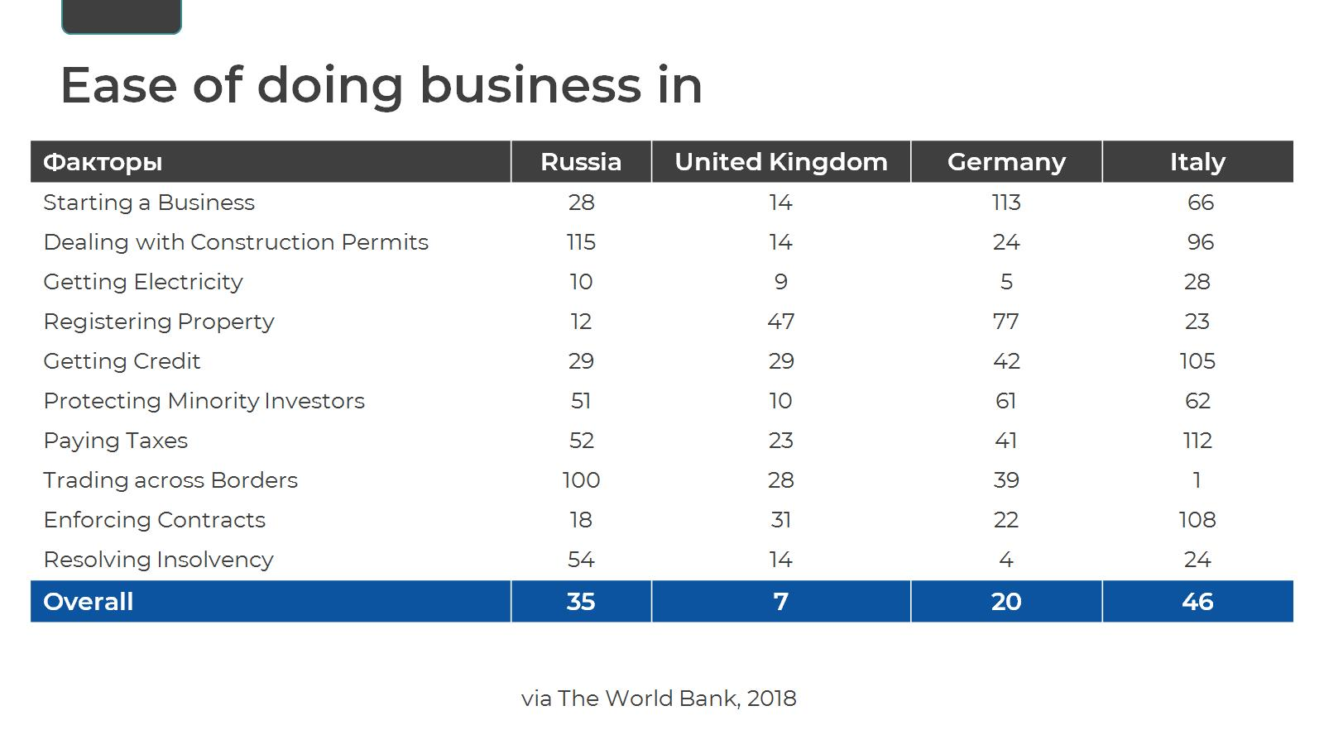
Ease of doing business in

Slide 7
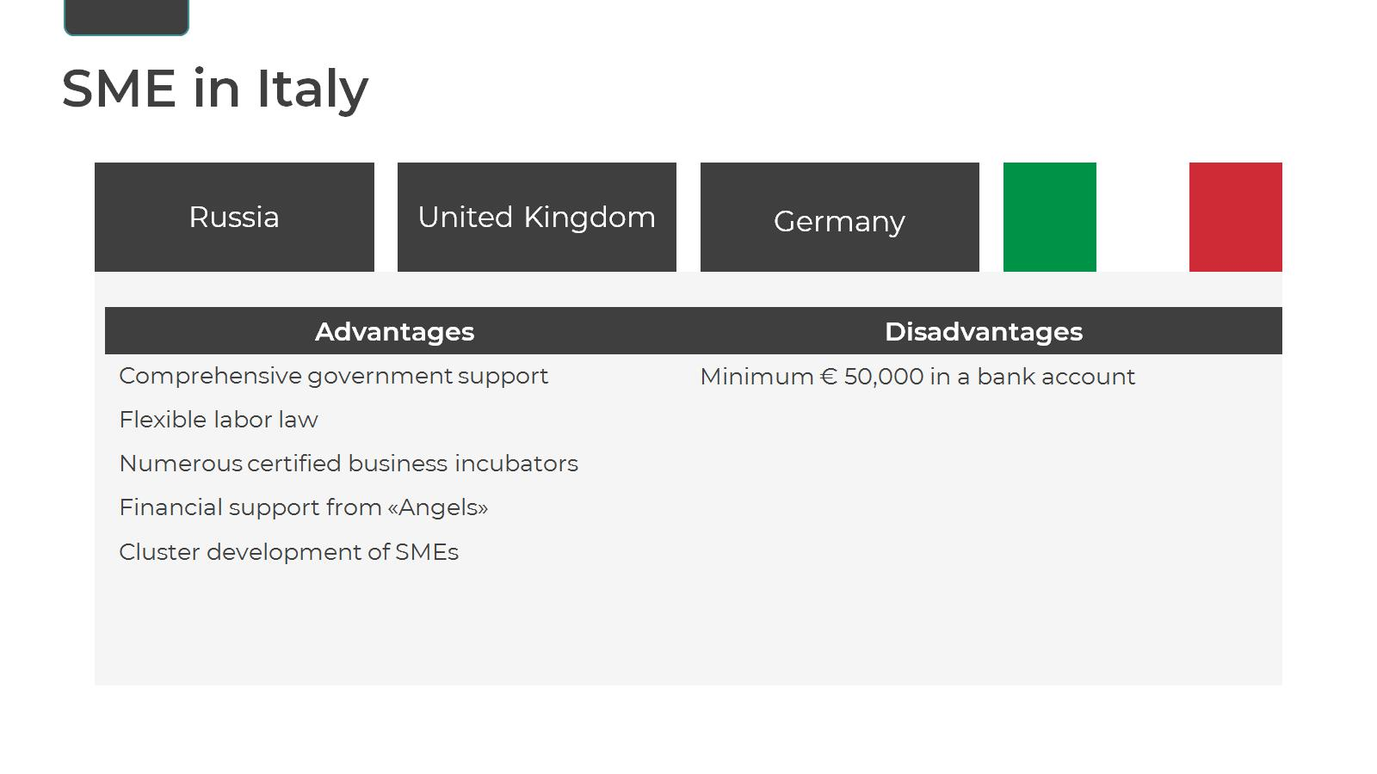

Slide 8
Starting a Business in Russia

Slide 10
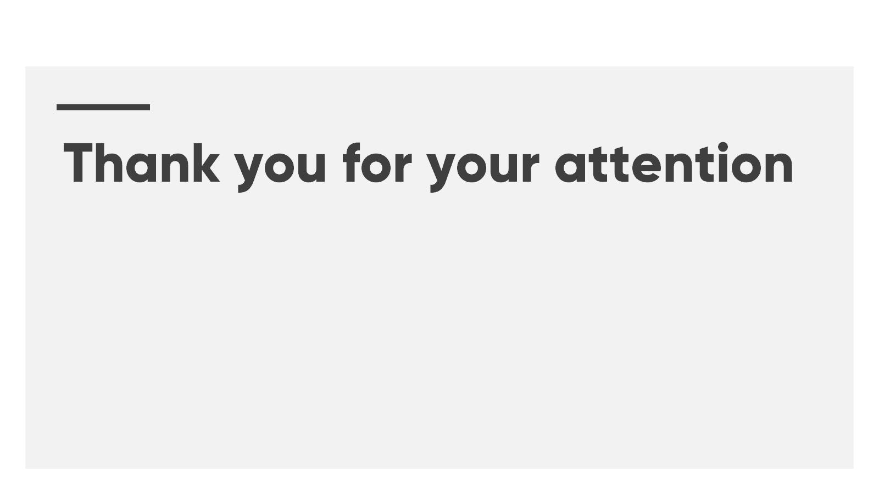
Thank you for your attention

